Slide 1



A study on
Industrial Growth and Employment Generation
in Telangana from 2019 to 2022
A Research Project by Kamal Banik
Top Ranked Data Science & Analytics Education Provider since 2007
Ivy Professional School - Top Ranked Corporate Education Provider

Slide 2
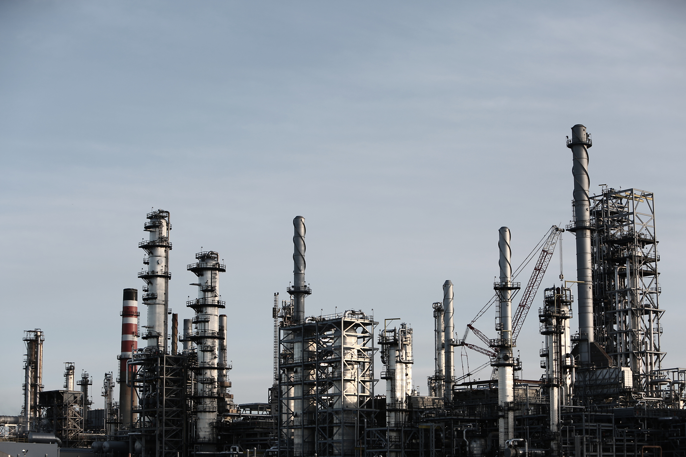
Content
Case Study
Objectives
Data Analysis
Findings
Conclusion
Top Ranked Data Science & Analytics Education Provider since 2007
Ivy Professional School - Top Ranked Corporate Education Provider

Slide 3
Case Study
The case study consists of dataset from Government of Telangana that shows data concerning units or businesses established within the state from fiscal year 2019 to 2022 under the "Industrial Project Approval and Self-Certification System" (iPASS). This government initiative aims to foster industrial growth and investment by streamlining project approvals and enabling self-certification for businesses.
The dataset comprises three tables - dim_date, dim_districts and investments.
Top Ranked Data Science & Analytics Education Provider since 2007
Ivy Professional School - Top Ranked Corporate Education Provider

Slide 4

Objectives
Analyse the datasets to find the top Districts that have witnessed significantly highest investment, top Sectors that contributed highest investment, Quarter wise investment trend and top Districts that have been benefited with highest employment generation.
Publish the findings based on Data Analysis.
Top Ranked Data Science & Analytics Education Provider since 2007
Ivy Professional School - Top Ranked Corporate Education Provider

Slide 5
Table analysis
This dataset consists of 3 tables.
First table is dim_date which consists of columns- Month, Quarter, Fiscal Year.
Second table is dim_districts which consists of columns- District code, District name.
Third table is investments which consists of columns- District code, Month, Sector, Investment amount in Cr, Number of employment.
Top Ranked Data Science & Analytics Education Provider since 2007
Ivy Professional School - Top Ranked Corporate Education Provider

Slide 6
Investment Timeline and The Sectors
2019
2020
2021
2022
Agro based incl Cold Storages
Automobile
Beverages
Cement, Cement & Concrete Products, Fly Ash Bricks
Electrical and Electronic Products
Engineering
Fertlizers Organic and Inorganic,Pesticides,Insecticides, and Other Related
Food Processing
Granite and Stone Crushing
Industrial Parks and IT Buildings
Paper and Printing
Pharmaceuticals and Chemicals
Plastic and Rubber
R&D
Real Estate, Industrial Parks and IT Buildings
Solar and Other Renewable Energy
Textiles
Thermal Power Plant
Wood and Leather
Others
Top Ranked Data Science & Analytics Education Provider since 2007
Ivy Professional School - Top Ranked Corporate Education Provider

Slide 7

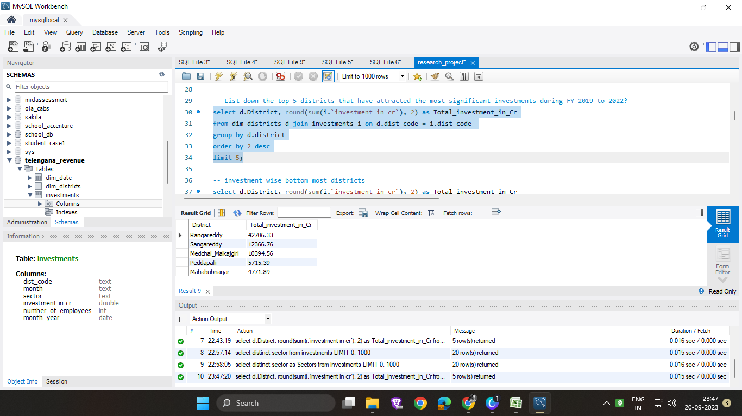
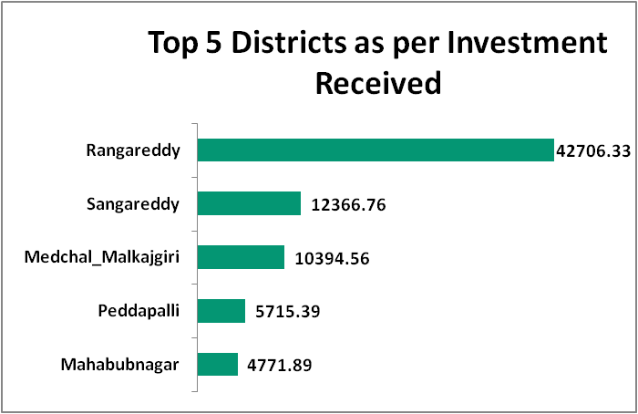

Top Districts that have witnessed highest Investment
Insight:
Out of a total investment of 99133.47 Cr, these five districts collectively received 75954.93 Cr, that constitute 76.61%.
Top Ranked Data Science & Analytics Education Provider since 2007
Ivy Professional School - Top Ranked Corporate Education Provider

Slide 8
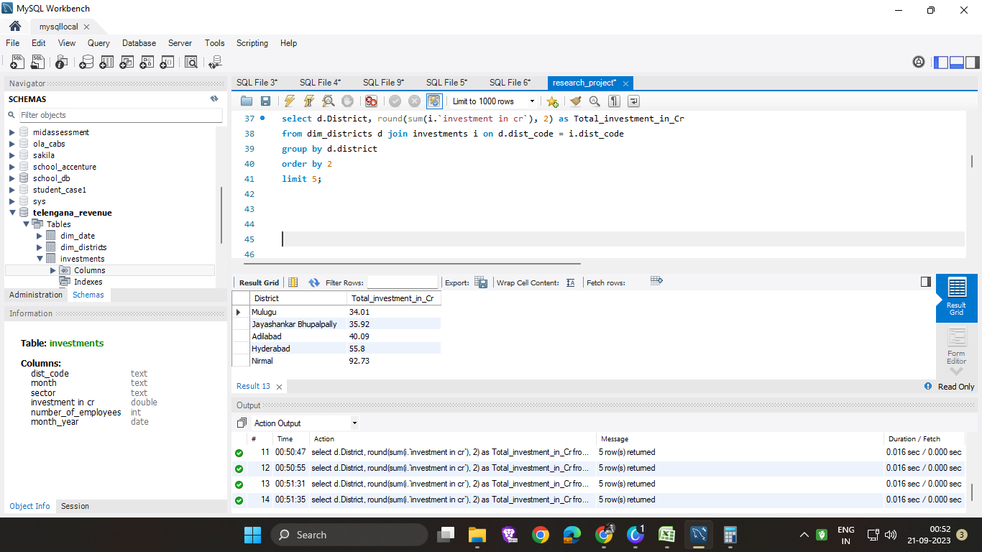
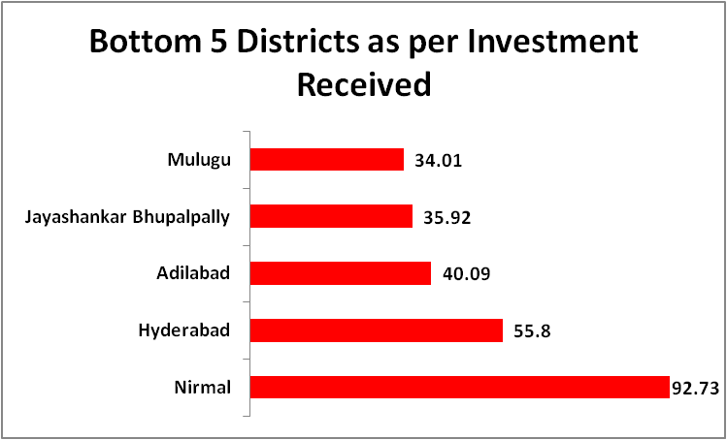
Districts that have witnessed least Investment
Insight:
Out of a total investment of 99133.47 Cr, these five districts collectively received 258.55Cr, that constitute only 0.26%.
Top Ranked Data Science & Analytics Education Provider since 2007
Ivy Professional School - Top Ranked Corporate Education Provider

Slide 9
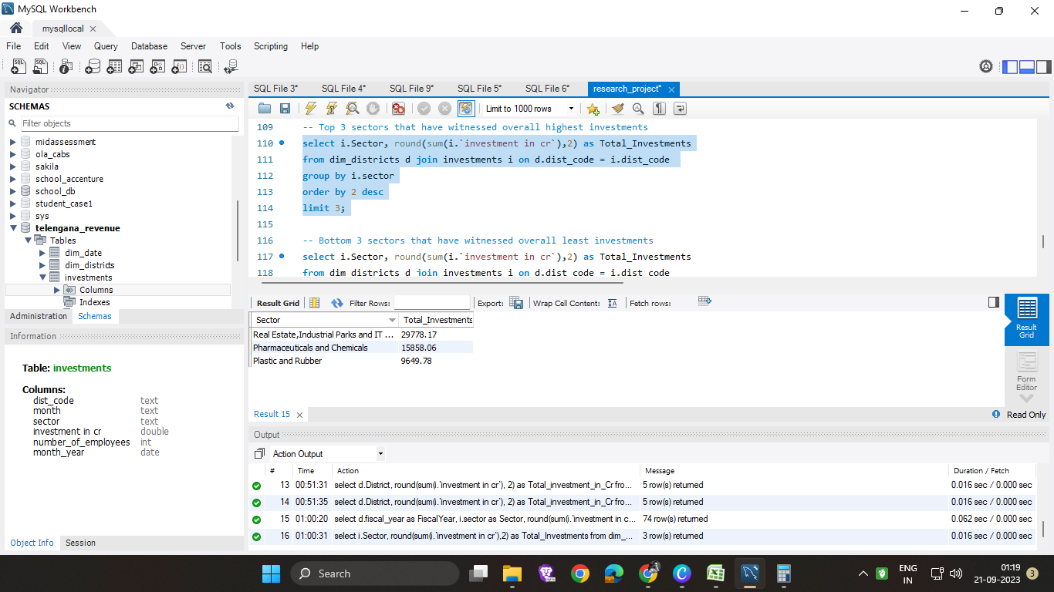
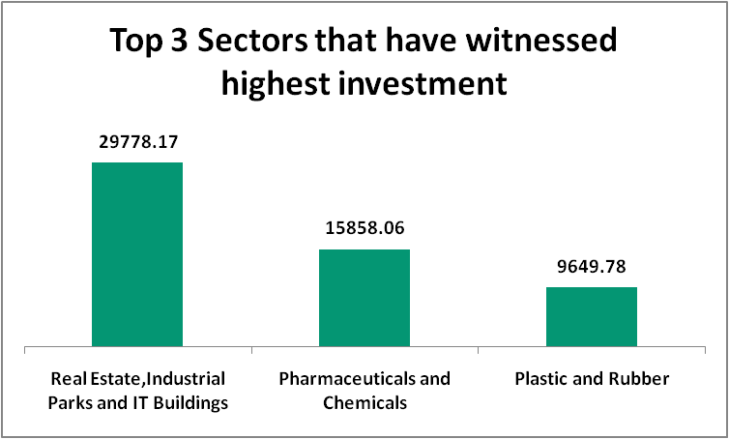
Sectors that have witnessed highest Investment
Insight:
These three sectors collectively received 55286.01 Cr, that constitute 55.76% of total investment i.e. 99133.47 Cr.
Top Ranked Data Science & Analytics Education Provider since 2007
Ivy Professional School - Top Ranked Corporate Education Provider

Slide 10
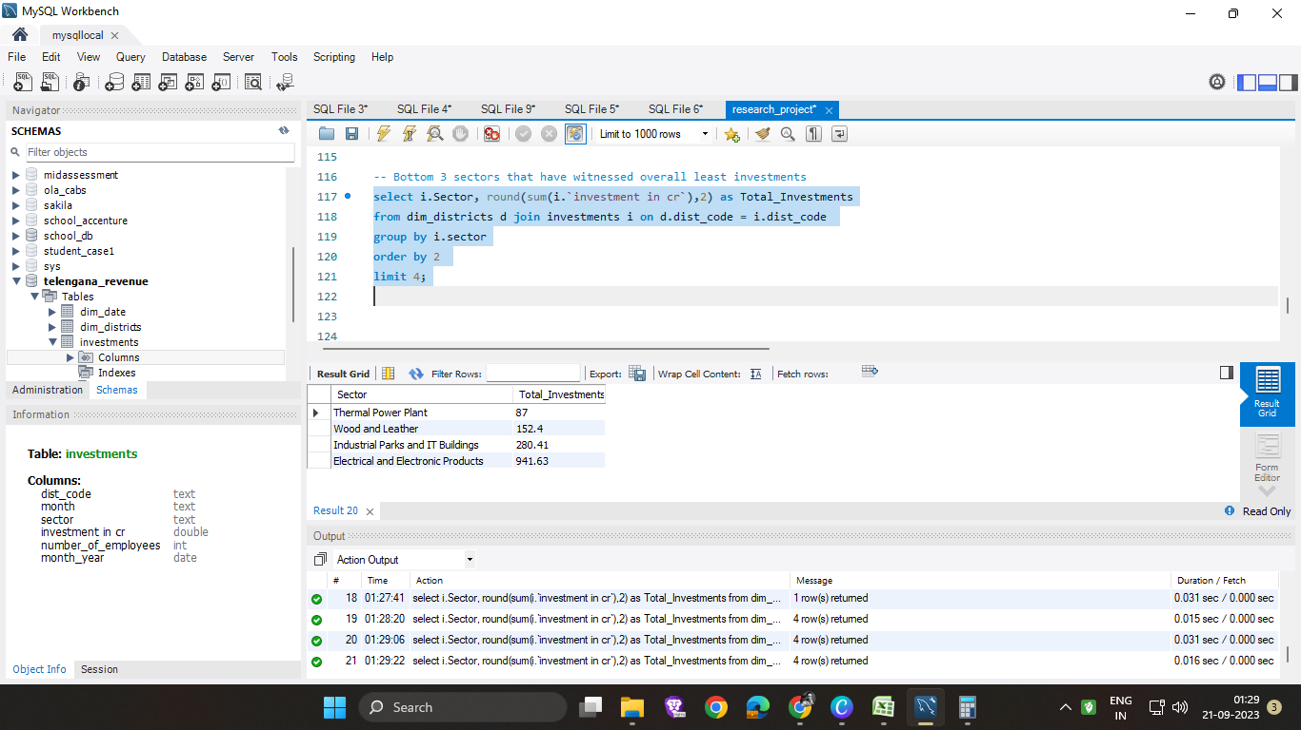
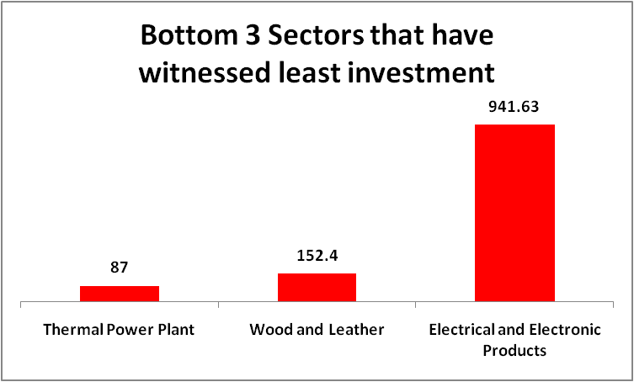
Sectors that have witnessed least Investment
Insight:
These three sectors collectively received 1181.03 Cr, that constitute only 1.19% of total investment i.e. 99133.47 Cr.
Top Ranked Data Science & Analytics Education Provider since 2007
Ivy Professional School - Top Ranked Corporate Education Provider

Slide 11
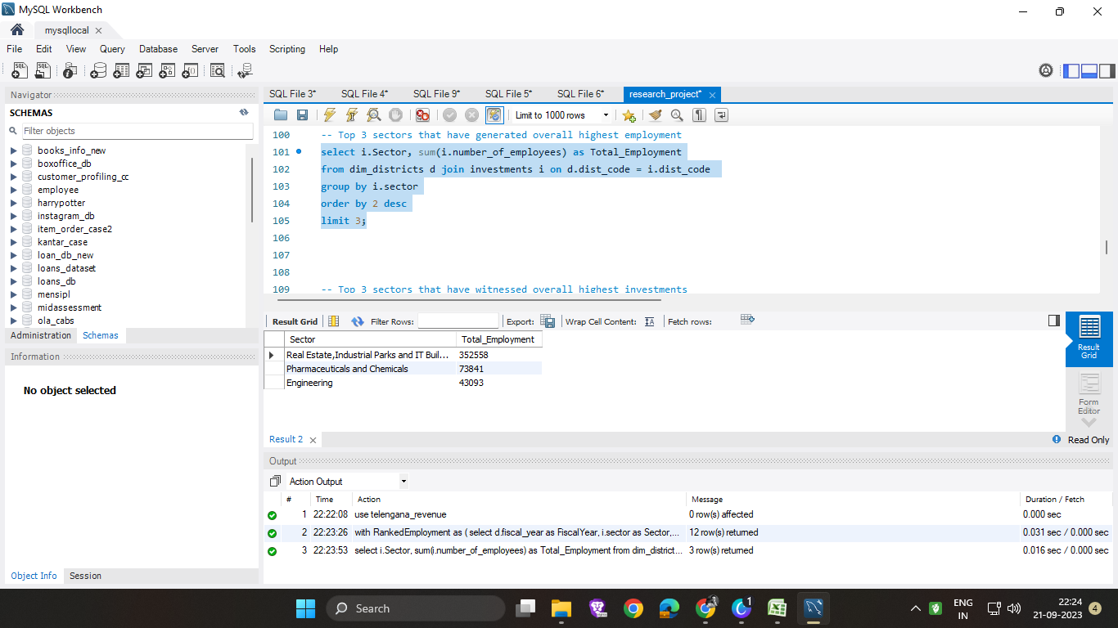
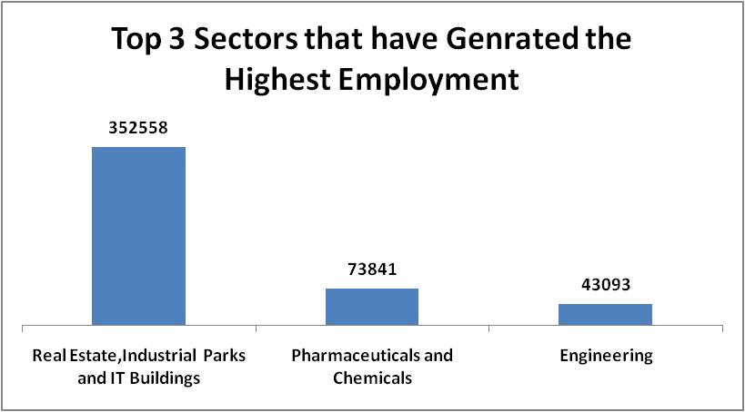
Sectors that have generated highest employment
Insight:
These three sectors contributed the most towards the growth of the state by employment generation
Top Ranked Data Science & Analytics Education Provider since 2007
Ivy Professional School - Top Ranked Corporate Education Provider

Slide 12
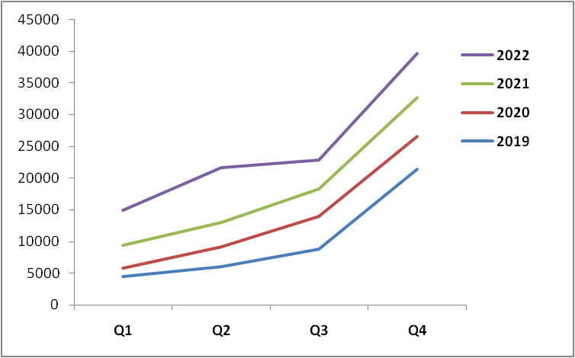
Quarter wise investment trend
Insight:
The trend shows that Quarter-4 has witnessed the highest investment in every year whereas Quarter-1 has witnessed the lowest investment.
Top Ranked Data Science & Analytics Education Provider since 2007
Ivy Professional School - Top Ranked Corporate Education Provider

Slide 13

Conclusion
There are scopes of improvement in mainly three areas-
1. Districts that have attracted least investment.
2. Sectors that have witnessed least investment.
3. Quarters that have seen least investment.
Top Ranked Data Science & Analytics Education Provider since 2007
Ivy Professional School - Top Ranked Corporate Education Provider

Slide 14
Thank You
Top Ranked Data Science & Analytics Education Provider since 2007
Ivy Professional School - Top Ranked Corporate Education Provider

